Slide 1
EXPERIMENT 07 // EXECUTIVE REPORTING
Microsoft Power BI Analytics
Advanced Diagnostic Analytics & Strategic BI Reporting
Transforming multi-dimensional Superstore transaction telemetry into root-cause operational insights, profitability controls, and leadership decisions.
PRIMARY DATASET
CORE ANALYTICAL FOCUS
PLATFORM
Global Superstore (51,290 Records)
Diagnostic Variance & Profit Optimization
Power BI Desktop & DAX Engine

Slide 2
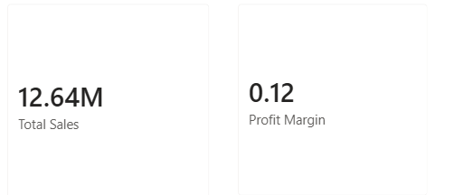
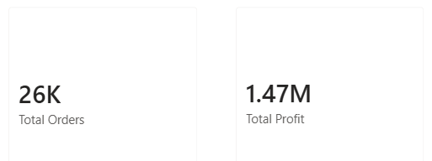
Performance Baseline
Executive Scorecard & Quota Variance
GROSS TURNOVER
TOTAL ORDERS
$12.64M
25,728
97.25% of Quota ($13M)
102.91% Target Achieved
NET OPERATING PROFIT
Profit Margin: 11.6%
$1.47M
97.83% of Target ($1.5M)
Key Diagnostic Takeaway
Transaction volume targets exceeded expectations (+2.91%), yet revenue and profit trailed slightly behind plan due to aggressive discount markdowns.

Slide 3
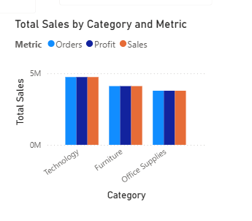
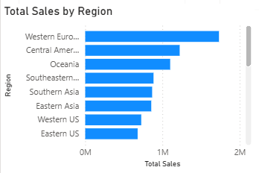


Multi-Dimensional Breakdown
Regional Sales Concentration & Category Margins
[ PASTE SCREENSHOT HERE ]
[ PASTE SCREENSHOT HERE ]
Figure 2A: Regional Turnover Ranking Bar Chart
Figure 2B: Category Sales vs. Profit Correlation
Geographic Skew
Category Margin Friction
Western Europe leads turnover ($1.73M+), followed by Central America ($1.2M+). Peripheral territories like Central Asia and Canada produce under 1.5% each, burdened by high freight friction.
Technology commands healthy profitability ($663K profit on $4.7M sales; 14.1% margin). In contrast, Furniture generates $4.1M+ sales but only ~$285K profit (~7% margin), indicating severe margin leakage.

Slide 4
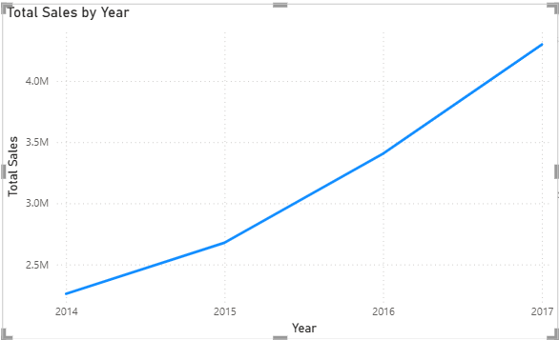
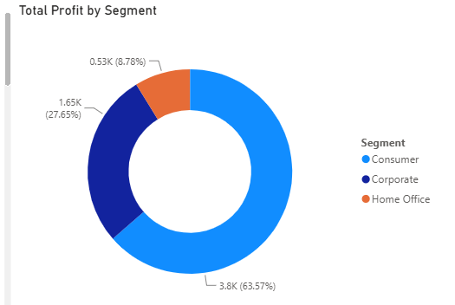


Longitudinal & Cohort Dynamics
Customer Profit Share & Multi-Year Growth Trend
[ PASTE SCREENSHOT HERE ]
[ PASTE SCREENSHOT HERE ]
Figure 3A: Profit Contribution by Segment Donut Chart
Figure 3B: Multi-Year Longitudinal Sales Curve (2014–2017)
Expansion Velocity: Annual turnover grew sustainably from ~$2.3M in 2014 to over $4.3M by 2017, confirming strong compound demand across mature accounts.
Segment Mix: Consumers drive 51.06% ($749K) of net profit, Corporate generates 30.07% ($441K), and Home Office contributes 18.88% ($277K).

Slide 5
Analytical Diagnostic
Evidence-Based SWOT Diagnostic Matrix
Validated Strengths
Operational Weaknesses
Strategic Opportunities
•
Technology Margin: High 14.1% margin contributing $663K profit.
•
Furniture Drag: Sinks to ~7% profit margin due to deep discounts.
•
Discount Governance: Restrict markdowns on bulky furniture items.
•
Volume Quota: Order transactions reached 102.91% of target.
•
Quota Shortfall: Missed top-line target by 2.75% ($12.64M vs $13M).
•
B2B Expansion: Scale recurring Corporate segment contracts.
•
Regional Scale: Western Europe dominates revenue at $1.73M+.
•
Territory Skew: Heavy revenue dependency on top 3 territories.
•
Logistics Consolidation: Reduce high freight costs in lagging zones.

Slide 6
Leadership Action Plan
Strategic Interventions & Governance Conclusion
INTERVENTION 01
INTERVENTION 02
INTERVENTION 03
Dynamic Discount Ceilings
Territory Logistics Review
Enterprise Tier Incentives
Enforce strict DAX/ERP rules capping furniture discounting to protect the baseline 12% contribution margin target.
Optimize regional distribution hubs to reduce shipping overhead in peripheral markets like Canada and Central Asia.
Transition Corporate accounts toward annual rebate structures rather than upfront discounts on high-margin Technology.
Executive Summary: Power BI diagnostic telemetry confirms strong baseline growth and high customer acquisition, requiring disciplined pricing governance to convert gross turnover into superior operating profit.
Exp 07 Evaluation Complete

